Slide 1
Why code – reasons, motivation and impact
Introductory information for presenting teams

Slide 2
Information for presenters

Slide 3
The purpose of this presentation pack
When can I use this presentation?
Working well with colleagues and stakeholders will be easier when they understand what a design code is and how it can benefit them and the local area. Their expertise and support are important for developing a successful design code. This slide deck is a presentation tool for coding teams to use when first engaging with people. Engage with people early in the design coding process so their input can be used to shape the code.
Section two has slides tailored to five key audiences:
Local community
Councillors
Development management and planning colleagues
Other planning authorities and other departments, such as Highways Authorities
Landowners, developers, and house-builders
We also have a video explaining design codes [link], which can be used with this presentation.
For additional resources for coding teams, please visit the Design Council website and the Office for Place.

Slide 4
Content
Section one (up to slide 25) introduces design codes and presents the general reasons for coding as described in the National Model Design Code and the National Planning Policy Framework. The reasons in section one should be relevant to everyone.
Section two provides slides with stakeholder-specific reasons to engage with the design coding process (from slide 26 onwards), as not all of the reasons and benefits of coding will be relevant to your audience.
This presentation pack was developed by the Design Council as part of the Department for Levelling Up, Housing, and Communities (DLUHC) Pathfinder programme.
Who should use it?
This slide deck was written and designed to be used by coding teams in Local Authorities or Neighbourhood Planning Groups. If you are thinking about preparing a code and/or leading the work, engaging others in the production as early as possible with the help of this slide deck.

Slide 5
How to use this presentation pack
Editing the slide deck
This presentation is intentionally editable, and we suggest you modify, add or delete any slides or images to add text and photographs that reflect your local context and character.
Some slides have two options for presenting: for brevity, a single summary slide, or a series of slides to expand upon. Consider using summary slides for more knowledgeable stakeholders, like development management officers, and a series of slides for others, like members of the public.
Presenting
We recommend presenting all the slides in section one. This includes an explanation of design codes, how they fit in with national planning policy, and the challenges they aim to resolve. From section two, present only the relevant slides for your audience.
Each slide presents a reason to develop a design code. The minimal text underneath the title is a summary with keywords. Full text can be found in the notes, which will help you talk through the slides.

Slide 6
Start to present from the next slide

Slide 7
Why code – reasons, motivation and impact
Presented by: Forename Surname

Slide 8
What is a design code?

Slide 9
According to the NMDC, “a design code is a set of simple, concise, illustrated design requirements that are visual and numerical wherever possible to provide specific, detailed parameters for the physical development of a site or area”.
It uses simple and concise design requirements (including ‘must-haves’) to build upon an existing local vision developed with the community or help establish one. It can be prepared at different spatial scales:
Authority or district-wide
Area-specific (town centre, neighbourhood plan area)
Site specific (Masterplan)
The Levelling Up and Regeneration Bill (LURB) seeks to require every planning authority to produce a design code for its area.
Image: National Model Design Code
Notes:
A design code sets out clear design parameters to help local authorities and communities decide what good design looks like in their area based on local aspirations for how the area will develop, following appropriate local consultation. They are a set of simple and concise illustrated and/or written design requirements that provide specific and detailed parameters for the physical development of a site or area.
When a design code is visual and numerical (rather than relying on detailed policy wording) it is not only easier to engage with but can provide a more specific steer on what is acceptable. The graphic and written components of the code should build upon a design vision, such as a masterplan or other design and development framework for a site or area.
Design codes are not voluntary guidance; they have mandatory requirements, and so are more likely to fundamentally improve design quality outcomes. The point of a code is that it is clear and binary. It uses words like ‘must’ and ‘will’ and includes measurable parameters.
Their definition, according to the NMDC, is: “A design code is a set of simple, concise, illustrated design requirements that are visual and numerical wherever possible to provide specific, detailed parameters for the physical development of a site or area.”
Design codes can be prepared at an authority or district-wide scale, area-specific or site specific scale. Codes can be prepared as part of a Local Plan or Supplementary Planning Document. In future, provisions in the Levelling Up & Regeneration Bill will allow them to be adopted as Supplementary Plans which will give design codes more weight in the planning system.

Slide 10
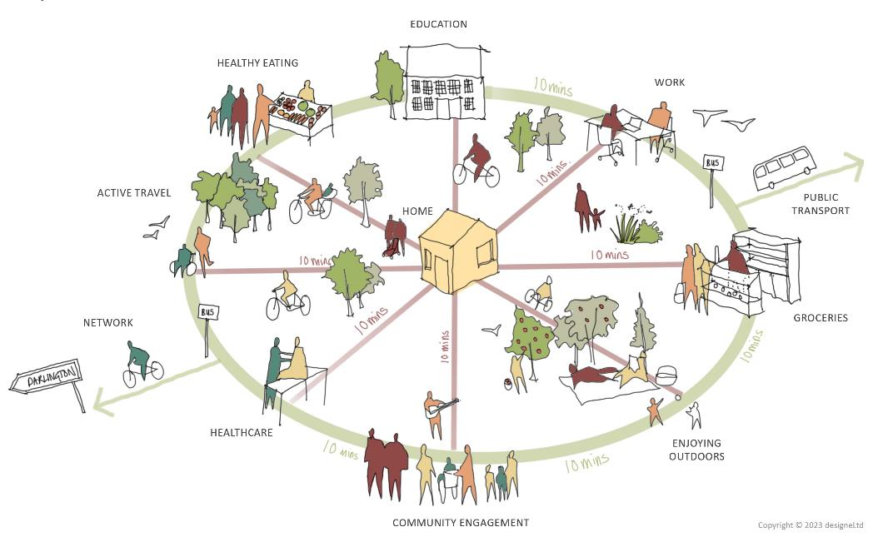
Design codes provide a framework for creating healthy, safe, green, environmentally responsive, sustainable and distinctive places, with a consistent and high-quality standard of design.
This can provide greater certainty for communities about the design of development and bring conversations about design to the start of the planning process, rather than the end.
National Model Design Code Part 1
The Coding Process
Department for Levelling Up,
Housing & Communities (DLuHC)
Image: DesigneLtd
Notes:
A design code sets out clear design parameters to help local authorities and communities decide what good quality design looks like in their area, based on local aspirations for how their area will develop, following appropriate local consultation.
They are a set of simple, concise, illustrated design requirements that provide specific, detailed parameters for the physical development of a site or area. When they are visual and numerical (rather than relying on detailed policy wording) design codes are not only easier to engage with but can provide a more specific steer on what is acceptable.
The graphic and written components of the code should build upon a design vision, such as a masterplan or other design and development framework for a site or area.

Slide 11
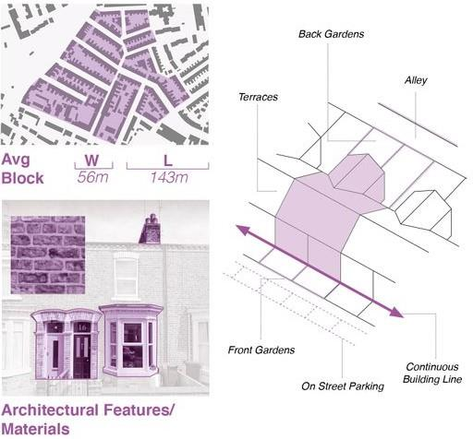
Design codes and design guides are different.
A design guide provides guidance on good practice for the quality of new development by setting out a series of key design principles. It relies on flexibility and the Local Authorities' interpretation of good design.
The Levelling Up and Regeneration Bill (LURB) seeks to require every planning authority to produce a design code for its area.
A design code, in contrast, is:
Binary (has yes/no answers)
Decisive (‘must’ rather than ‘should’)
Focussed on key policy areas
Responsive to localities
Derived locally
In support of the Local Plan
It provides the planning department with criteria to allow them to easily and confidently determine whether development proposals will deliver the vision for the area.
Image: National Model Design Code
Notes:
Design codes and design guides are NOT the same.
A design guide provides guidance on good practice on the quality of new development by setting out a series of key design principles. It relies in flexibility and the Local Authorities' interpretation of what good design looks like.
Design codes codify existing local policy and guidance, putting them into numbers and rules that are easy to understand and follow.
Design codes are not voluntary guidance; they have mandatory requirements and are more likely to fundamentally improve design quality outcomes. The point of a code is that it is unambiguous and binary. It uses words like ‘must’ and will’ and includes parameters.
Design codes will reference our existing local policy and guidance and will codify these into clear, concise and illustrated design requirements.
Design codes are not the only tool available to bring about good design. Design codes can be supplemented by design guides and guidance but the latter is more flexible and open to interpretation.

Slide 12
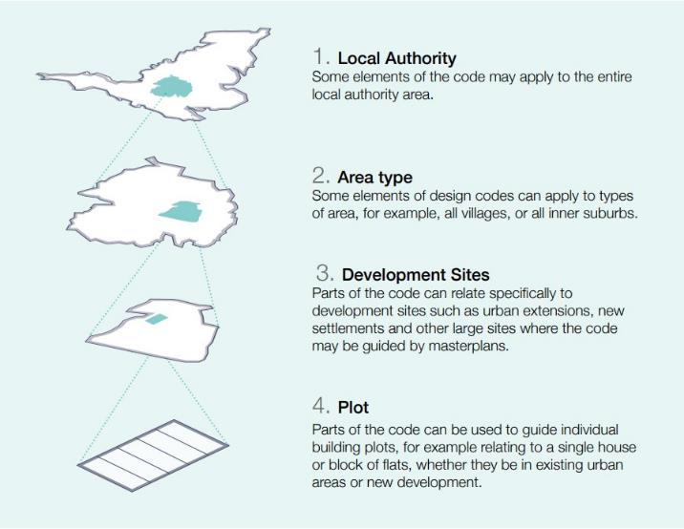
A design code can be prepared at different spatial scales:
Authority or district-wide
Area-specific (town centre, neighbourhood plan area)
Site specific (Masterplan)
Different coding scales will affect the details of the elements you code for.
A design code is an opportunity to identify the key design challenges you face (at different spatial scales) and address these through clear design standards.
Image: National Model Design Code

Slide 13
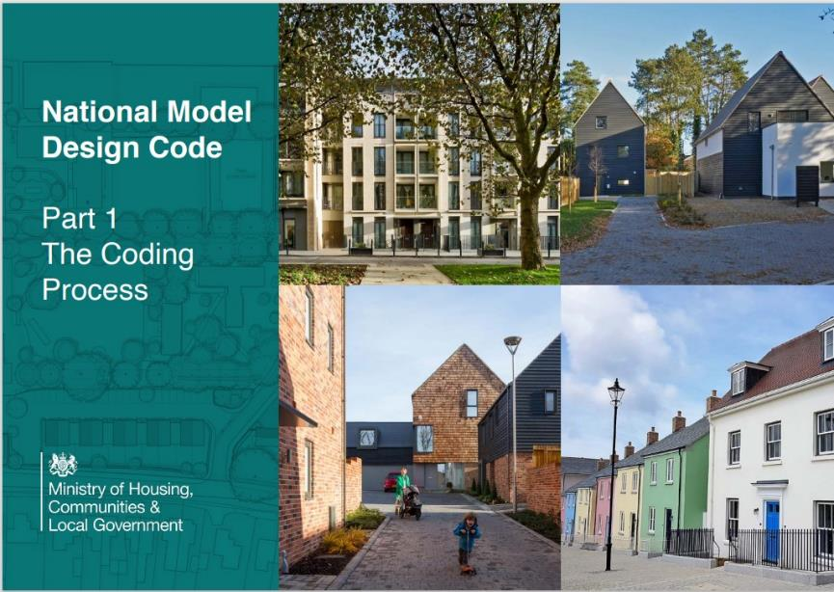
Design codes in national planning policy
The National Planning Policy Framework (NPPF) sets a policy for the expectation for the preparation of local design guides and codes consistent with the principles set out in the National Design Guide (NDG) and National Model Design Code (NMDC)
The NDG sets out the ten characteristics of well-designed places.
The NMDC supports councils in translating these characteristics into local standards through a design code.
In the absence of a local design guide or design code, the NDG and NMDC should be used to guide planning decisions (NPPF Para 129).
Notes:
The National Planning Policy Framework (NPPF) sets a policy for the expectation for the preparation of local design guides and codes consistent with the principles set out in the National Design Guide (NDG) and National Model Design Code (NMDC)
Both the NDG and NMDC are Design Guidance.
The National Design Guide (NDG) illustrates how well-designed places that are beautiful, enduring and successful can be achieved in practice. It is a vital starting point, defining ten characteristics of successful places and the ingredients that can deliver these. However, these broad principles need to be turned into more specific standards in order to provide as much clarity as possible for applicants and communities and to provide the basis for ‘fast-tracking’ decisions on design. Specific, detailed and measurable criteria for good design are most appropriately set out locally. And design codes are the tool to use.
The National Model Design Code (NMDC) forms part of the government’s planning practice guidance. It is a toolkit to guide local planning authorities on the design parameters and issues that need to be considered and tailored to their context when producing design codes, as well as methods to capture and reflect the views of the local community from the outset, and at each stage in the process. This sets a baseline standard of quality and practice, which local planning authorities are expected to consider when developing local design codes. The NPPF is clear that design policies should be developed with local communities so that they reflect local aspirations. Local authorities should also collaborate with developers and landowners on design codes, particularly in relation to specific sites.
The NPPF makes clear that all local planning authorities must prepare design codes consistent with the principles set out in the NDG and NMDC and which reflect local character and design preferences. It is also clear that local planning authorities should develop an overarching design vision that can support design codes, guides and other tools that inform the built and natural environment in their area.
The NPPF says that in the absence of locally produced codes, the NDG and NMDC should be used to guide application decisions. We must use a design code specific to our local vision, character and needs rather than a generic national one.

Slide 14
Design codes and the local plan
Add here bullet points on how your code aligns with local plan policies

Slide 15
Why should we develop a local design code?

Slide 16
Key challenges
Unclear quality asks from the planning system
Houses not places
Opposition to new homes
Non level playing field from planning puts downward pressure on quality
Despite support in principle, opposition on the ground to new development
High land costs and pressure on build costs
Constrained allocation of new homes
Insufficient new homes in the right place
Graphic adapted from:
Vicious circle of parasitic development
From: Living with Beauty: report of the Building Better, Building Beautiful Commission
Notes:
Based on the findings from the Living with Beauty: report of the Building Better, Building Beautiful Commission. We can say:
The current challenges are characterised by unpopular and unsustainable new development, often in less-than-ideal locations. This has led to a prevailing reluctance towards new housing despite theoretical support. Moreover, the political discourse surrounding development and planning has often oversimplified the matter, unfairly placing blame on either developers or planners. This has eroded public confidence in both the industry and its regulators.
To break from this cycle (depicted above), a transition into a more favourable one marked by straightforward and predictable regulations within land use planning is necessary, like Design Codes. These regulations should be subject to effective democratic control, ensuring that a higher proportion of new developments are not only aesthetically pleasing but also contribute positively to existing communities and residents' well-being. The implementation of Design Codes can be a pivotal tool in this transformation. By providing clear and comprehensive guidelines for development, Design Codes promote beauty, community integration, and environmental stewardship.

Slide 17
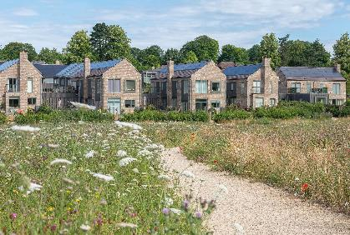
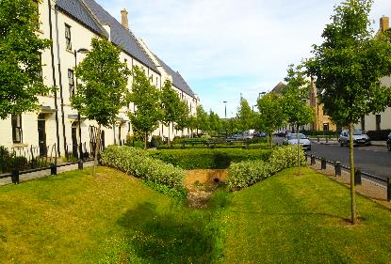
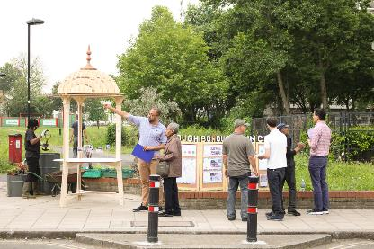
What can a design code do?
Help to create well-designed and sustainable places.
Provide clarity for developers about what is expected.
Support a faster, more transparent planning system.
Improving public engagement in the transformation of their places
Design Council
Image (top to bottom): Pete Humphry, Kevin R Twigger and Associates, Make Good
Notes:
Design Codes play a role in addressing the challenges of unsustainable development and fostering a more desirable urban landscape:
Well-Designed and Sustainable Places: Design codes define key design principles that address repeated and common design problems. They have specific and quantifiable ‘targets’ to set design parameters and ensure we receive proposals that are suited to our local area, its context, aspirations and needs. This will reduce the likelihood of receiving non-compliant and poor-quality planning applications. A design code can significantly contribute to creating well-designed places by providing a clear framework for development.
Clarity for Developers: They offer clarity to developers regarding what is expected of them. By clearly outlining the design principles and requirements, developers can streamline their planning processes, reduce ambiguity, and make informed decisions. This not only saves time and resources but also fosters a cooperative atmosphere between developers and planning authorities.
Streamlining Planning Procedures: Design Codes support a more efficient and transparent planning system. They enable local authorities to make quicker and more consistent decisions by providing a standardised framework for assessing development proposals. This benefits developers by reducing the time and uncertainties associated with planning applications, thereby accelerating the development process.
Empowering Public Engagement: Design Codes enhance public engagement by making the design and development process more accessible to the community. Through clearly defined design expectations and opportunities for public input, residents can actively participate in shaping the transformation of their neighbourhoods. This engagement not only ensures that community voices are heard but also results in developments that better align with the aspirations and needs of the people who live in these areas.

Slide 18
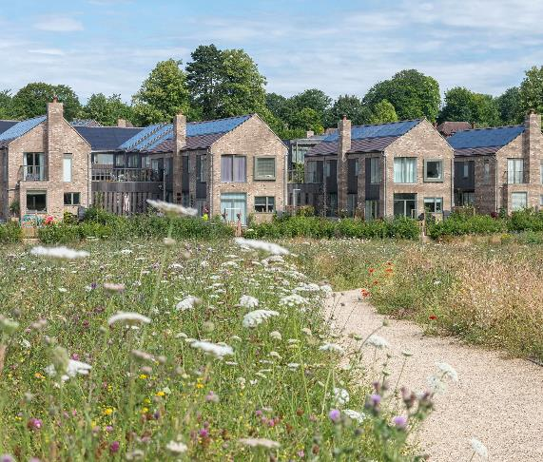
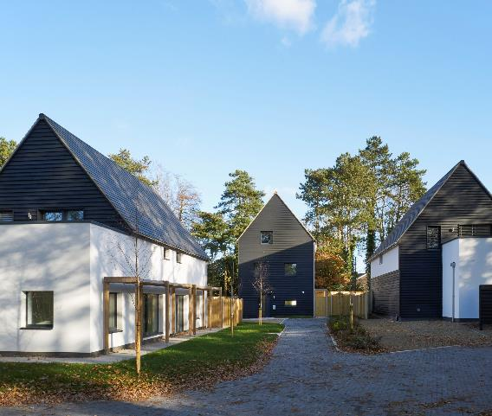
Well-designed and sustainable places
Key design principles explicitly address local challenges
Specific and quantifiable targets
Reduce non-compliant and poor-quality applications
Design Council
Image (left to right): Pete Humphry, Jefferson Smith, Geoff Henson
Notes:
Design codes define key design principles that address repeated and common design problems. They have specific and quantifiable ‘targets’ to set design parameters and ensure Local Authorities receive proposals suited to the local area, its context, aspirations and needs. This will reduce the likelihood of receiving non-compliant and poor-quality planning applications.
A code helps translate good design practices into tangible design elements. It ensures they are consistently applied across various developments, resulting in well-designed places that positively impact communities and the climate.

Slide 19
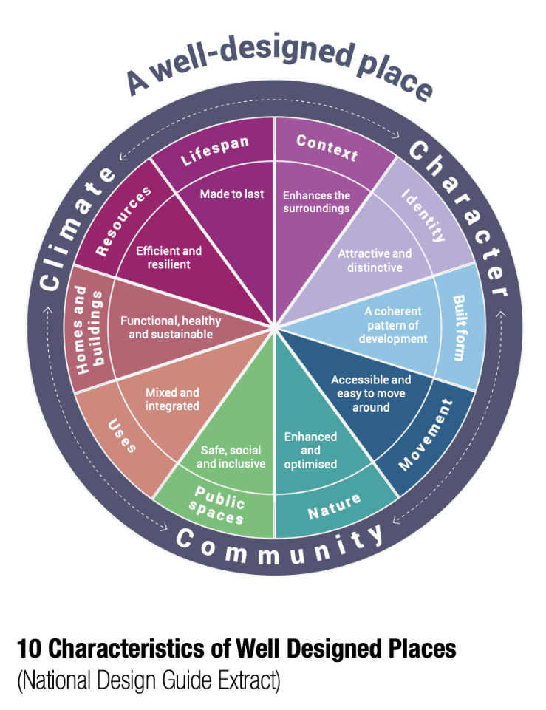
The National Model Design Code sets a baseline of characteristics for well-designed places:
Health and wellbeing of local communities
Safe, inclusive, accessible and active environments
Landscape, green infrastructure and biodiversity
Environmental performance of place and buildings
Layout, including infrastructure and streets
Building façades, materials
Local character and heritage
Notes:
The NMDC sets a baseline standard of quality and practice which local planning authorities are expected to take into account when developing local design codes.
It includes the following:
How the design of new development should enhance the health and wellbeing of local communities and create safe, inclusive, accessible and active environments
How landscape, green infrastructure and biodiversity should be approached, including the importance of streets being tree-lined
The environmental performance of place and buildings, ensuring they contribute to net zero targets
The layout of new development, including infrastructure and street pattern
The factors to be considered when determining whether façades of buildings are of sufficiently high quality
That developments should take account of local vernacular, character, heritage, architecture and materials

Slide 20
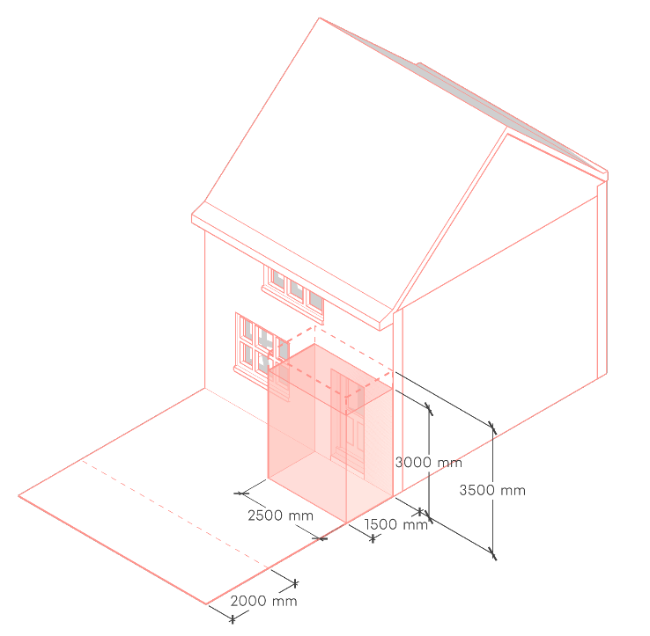
Clarity about what is expected
Clear requirements setting out an unambiguous interpretation of planning policy and guidance.
Benefits:
Development management officers can quickly assess compliance
Developers can confidently predict expectations for design and manage risk
The community can be confident that development will meet standards set in the local design code
Image: Be First
Notes:
Design codes provide an unambiguous interpretation of planning policy and guidance, turning them into a clear set of requirements.
This benefits:
the development management officer, who can more confidently reject non-compliant applications;
developers will have more certainty about what is expected of their design proposals
the community is confident that successful planning applications will meet standards/parameters set in the local design cod

Slide 21
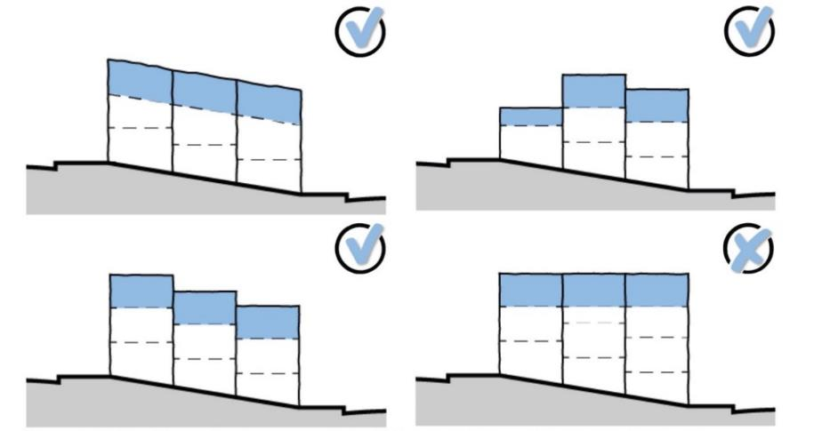
A faster, more transparent planning system
Design codes front-load the planning process, clarifying design expectations at an early stage.
Compliance guarantees better quality of design and local issues addressed. This means:
Quicker and easier to determine compliance
Better risk management
Less confrontational planning process
Community buy-in to a code, and this should reduce opposition on design grounds
Image: Bradford Council
Notes:
The NPPF has “a presumption in favour of sustainable development, which in terms of decision-making means approving development proposals that accord with an up-to-date development plan without delay”.
Design codes front-load the planning process by requiring applications to address key issues and poor quality before schemes. The unambiguous language, specific and quantifiable targets, and key design principles must be complied with to be approved, so no time is wasted on speculative design proposals that will likely be refused.
Design codes provide maximum clarity about design expectations at an early stage, allowing both developers and development management officers to assess compliance quickly, have more productive pre-app discussions, and fast-track consents.
At the application stage, any scheme that complies with the design code should go through the planning process more quickly and easily, as key considerations have already been accounted for. There should be less need for negotiations or changes to the proposals, which can impede local planning authorities from issuing timely decisions. We want to ensure that applicants do not experience unnecessary delays and costs.
A Code that is easy to read and understand will help local planning committees to make more informed decisions. Community buy-in to a code, and this should reduce opposition on design grounds.

Slide 22
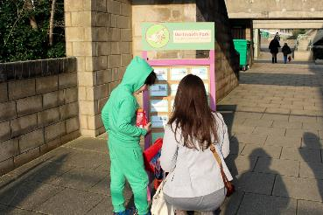
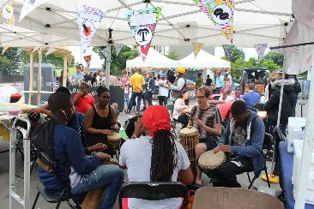
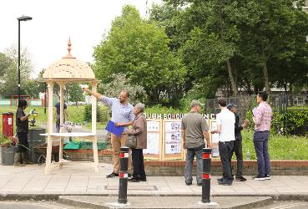
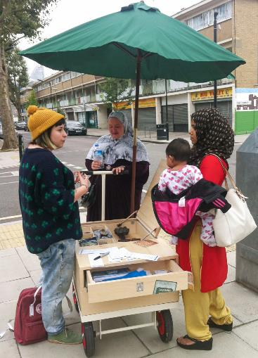
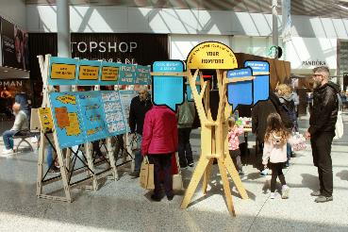
Engaging people in the transformation of their places
Community engagement is ongoing through the design code’s development.
Community involvement during the preparation of design codes can provide evidence of what is popular local.
Neighbourhood Planning Groups can play an important role:
Identify special qualities of the place
Articulating the community’s vision
Design Council
Images: Make Good
Notes:
One of the main aims of design codes is to get more people and communities involved in the planning process so that they have a say in the growth and development of the place where they live. The community will be engaged throughout the design code’s development so that their aspirations are embedded and there is a local interpretation of creating healthy, safe, green, environmentally-responsive, sustainable and distinctive places, with a consistent design standard.
The NMDC says that design codes should be prepared based on evidence about what is popular locally about design expectations. This will address the ambition for communities to decide what good design means to them and ensure that this is enshrined in design codes.
Design codes will provide greater certainty for communities and developers about the design and bring conversations about design to the start of the planning process rather than the end.
The community will be engaged throughout the process of developing a design code.
Neighbourhood planning groups can play an important role in identifying the special qualities of each area and explaining how this should be reflected in development, both through their plans and by engaging in the production of design policy, guidance and codes by local planning authorities and developers.

Slide 23
How can you benefit from a design code?

Slide 24
Coding streamlines the application process
Self-Assessment
Easily identify in a code the design requirements relevant to the location/nature of a development proposal
Pre-app
Developers can self-assess compliance from early design stages
More productive and less confrontational pre-app discussions
Helps risk management with clear design expectations set from the start
Submission
Clearer submissions when a code requires compliance checklists
Consultation
Compliance with the code means developments are in line with community aspirations
Assessment
Grounds for acceptance are clear and unambiguous
Less confrontational negotiations or discussions
Sensitive locations (e.g., heritage) already have the necessary level of detail
Local Planning Committee or appeals
Compliance facilitates decisions because of the binary nature of code
Language is unambiguous, less open to misinterpretation and familiar to non-planners
Notes:
Design codes front-load the planning process, so you can use design codes to brief designers and develop and submit compliant applications that are more likely to be successful on design grounds. This results in an easier and faster planning process for all parties.​
​
SELF-ASSESSMENT
Easily identify in a code the design requirements relevant to the location/nature of a development proposal.
PRE-APP​
Take maximum advantage of the pre-application stage and use the design code as a compliance checker before submitting a planning application​
The more issues that can be resolved at the pre-application stage, the less costly and time-consuming the process will be.​
A design code reduces the need for conversations around design 'basics' and creates an opportunity for more productive pre-app discussions​
Engaging with the local community at pre-app will allow you to test your scheme for popularity and reduce the likelihood of objections at the statutory consultation phase.​
SUBMISSION AND VALIDATION​
The process will clarify what you must submit with the application and in which formats.​
CONSULTATION​
As mentioned above, this process stage should be less contentious as engaging the community and stakeholders at pre-app should result in a more popular scheme being submitted and fewer objections at this point in the planning process.​
ASSESSMENT/ DETERMINING APPLICATIONS:​
- The NPPF says that application decisions should be made quickly.​
Design codes that are part of local and supplementary plans are a material consideration. When they set clear standards, this will facilitate both self-assessment and assessment by planning officers.​
Agreeing conditions early is beneficial to all parties involved in the process and can speed up decision-making; there will be less interpretation needed, less confrontation, and fewer negotiations that can tend to slow down the process and be costly for applicants and the Local Planning Authority.​
Local Planning Committee​
Design code makes it easier to assess and determine applications against clear requirements so the Local Planning Committee can make an informed decision on the compliance of an application.​

Slide 25
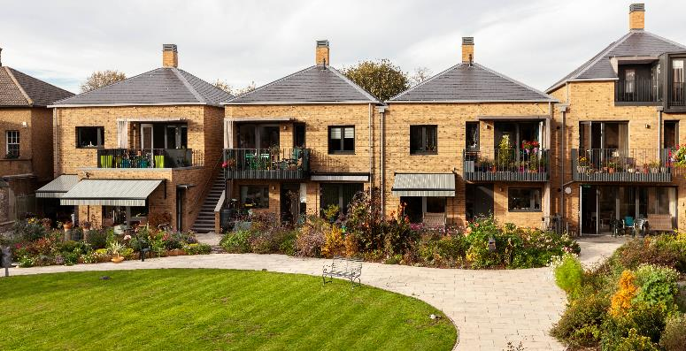
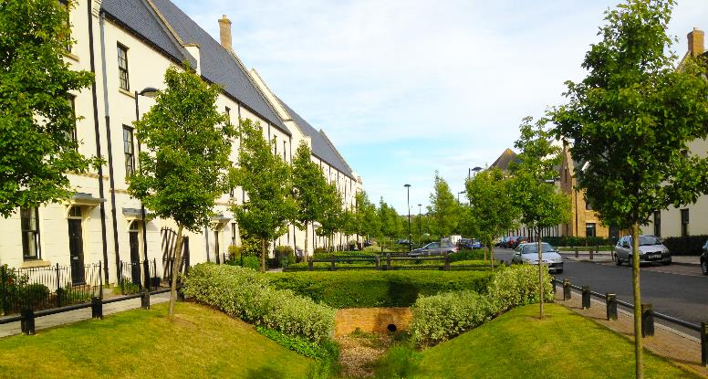
Coding for phased development
Design codes are particularly helpful for larger-scale phased development because:
Core design requirements can be mandated and consistently applied throughout the lifecycle of the development, ensuring good design is not diluted
Compliance with the code could be enforced by condition on the grant of permission
They ensure land and resources are used efficiently and sustainably with green and net zero solutions designed from the outset.
Design Council
Image (top to bottom): Pollard Thomas Edwards, Kevin R Twigger and Associates
Notes:
The NPPF suggests that the supply of large numbers of new homes can often be best achieved through planning for larger-scale development, such as new settlements or significant extensions to existing villages and towns, provided they are well-located, designed and supported by the necessary infrastructure and facilities (including a genuine choice of transport modes). For larger schemes, such as phased developments, design codes can help to maintain consistency in the delivery of development over a longer period.
Working with the support of their communities and with other authorities if appropriate, strategic policy-making authorities should identify suitable locations for such development where this can help to meet identified needs sustainably. To do so, local authorities are expected to:
- Set clear expectations for the quality of the places to be created and how this can be maintained (such as by following Garden City principles); ensure that appropriate tools such as masterplans and design guides or codes are used to secure a variety of well-designed and beautiful homes to meet the needs of different groups in the community
Use area-based character assessments, design guides and codes, and masterplans to help ensure that land is used efficiently while also creating beautiful and sustainable places
Where there is an existing or anticipated shortage of land for meeting identified housing needs, planning policies and decisions must avoid homes being built at low densities and ensure that developments make optimal use of the potential of each site.
They can help facilitate modern construction methods and should not constrain technical and environmental innovation.

Slide 26
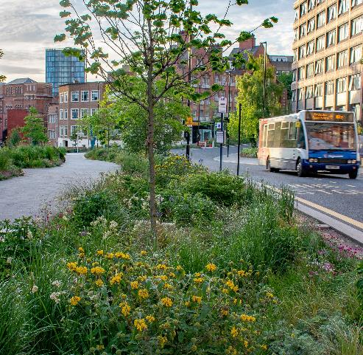
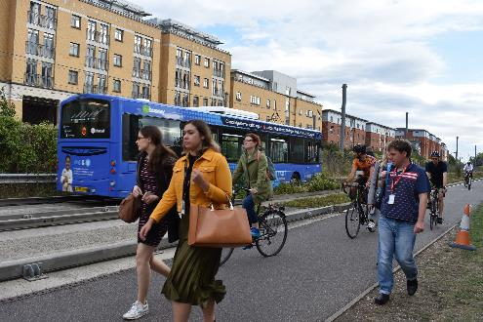
An opportunity to update local guidance
Design codes build on the local design vision set in the Local Plan or they can help create one developed with the community. This is an opportunity to update highway standards to align with the popular vision
Active travel
Pedestrian-friendly streets
Functional green infrastructure
Welcoming and attractive public realm projects
Image (top to bottom): Nigel Dunnett, Design Council
Notes:
We know that highway authorities operate under different regulations and other authority controls.
We are developing a new design code, as mandated by the NPPF.
Design codes build on a local vision developed with the community to make the results popular and well-received.
We thought this provided a great opportunity to talk to you about how highway standards might be updated to align with what our community says they want and need from where they live, work and play.
Many exemplar and precedent schemes were achievable within budget, most of which were trialled successfully during and post-COVID. These are pleasant and sustainable places in other parts of the country.

Slide 27
Opportunity to shape the code together
We are meeting at this early stage to:
Align placemaking and movement objectives, including decarbonisation targets and support you in delivering them.
Understand how we can update guidance to align with best practice, such as the forthcoming Manual for Streets, or introduce elements of this into the code itself
Ensure highway authorities take an active role in the development of design codes
Design Council
Image: Tom Perry
Notes:
Design codes define key design principles that address repeated and common design problems. They have specific and quantifiable targets to enforce design quality and ensure we receive proposals suited to our local area’s context, aspirations, or needs. This will reduce the likelihood of receiving non-compliant and poor-quality planning applications.

Slide 28
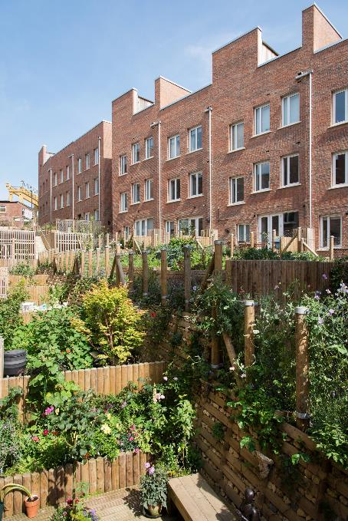
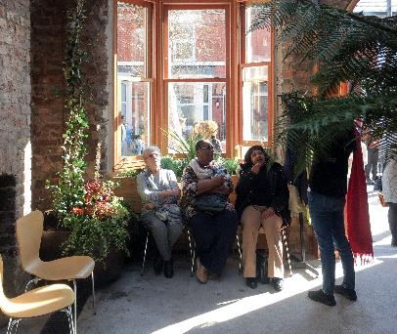
Placemaking impacts people’s lives
Image (top to bottom): Assemble, John Sturrock
Image: Ash Sakula Architects/ Jill Tate
An opportunity to:
Bring together a broad range of stakeholders to shape local design code
To create partnerships for the future
Align workstreams
Share your expertise

Slide 29
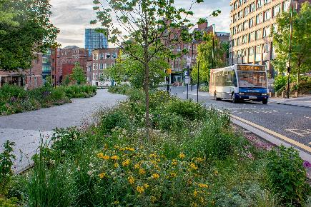
Opportunity to shape the code together
We want to deliver quality places by involving bodies with an interest in:
Net zero, climate resilience, decarbonisation
Health and wellbeing of local communities
Safe, inclusive, accessible and active environments
Landscape, green & blue infrastructure and biodiversity
Environmental performance of place and buildings
Utilities, street layout, waste management
Local character and built heritage
Education, training, and employment
Image (top right and bottom): Nigel Dunnett, Geoff Henson

Slide 30
A faster and more predictable process
Design codes can facilitate more sustainable development, modern methods of construction, and innovation. The benefits of a code include:
Making the planning process more predictable
Avoiding unnecessary costs and delays as expectations are clear from the start
For larger schemes that will take longer to deliver, design codes:
Maintain long-term consistency
Help multiple developers and/or landowners to work together

Slide 31
Coding streamlines the application process
Self-Assessment
Easily identify in a code the design requirements relevant to the location/nature of your development proposal
Pre-app
You can self-assess your compliance from the early design stages
More productive and less pre-app discussions on design grounds
Helps risk management with clear expectations set from the start
Submission
Greater clarity on what you need to submit and how
Consultation
Compliance with the code means your development is in line with community aspirations
Assessment
Grounds for acceptance are unambiguous
Less confrontational negotiations or discussions
Sensitive locations (e.g., heritage) already have the necessary level of detail
Local Planning Committee or appeals
Compliance facilitates decisions because of the binary nature
Language is unambiguous and less open to misinterpretation
Fewer cases of committee call-ins on design grounds
Notes:
Design codes front-load the planning process, so you can use the design codes to brief designers and develop and submit compliant applications that are more likely to be successful. This results in an easier and faster planning process for all parties.​
​
PRE-APP​
Take maximum advantage of the pre-application stage and use the design code as a compliance checker before submitting a planning application​
The more issues that can be resolved at the pre-application stage, the less costly and time-consuming the process will be.​
A design code reduces the need for conversations around design 'basics' and creates an opportunity for more productive pre-app discussions​. This will also save you time and money and give you more confidence that design expectations won't change once you submit a proposal
Engaging with the local community at pre-app will allow you to test your scheme for popularity and reduce the likelihood of objections at the statutory consultation phase.​
SUBMISSION AND VALIDATION​
The process will clarify what you need to submit with the application and in which formats.​
CONSULTATION​
As mentioned above, this stage of the process should be less contentious as engaging the community and stakeholders at pre-app should result in a more popular scheme being submitted, and fewer objections at this point in the planning process.​
ASSESSMENT/ DETERMINING APPLICATIONS:​
- The NPPF says that decisions on applications should be made as quickly as possible.​
Design codes that are part of local and supplementary plans are a material consideration. When they set clear standards, this will facilitate both self-assessment and assessment by planning officers.​
Agreeing conditions early is beneficial to all parties involved in the process and can speed up decision-making; there will be less interpretation needed, less confrontation, and fewer negotiations that can tend to slow down the process and be costly for applicants and the Local Planning Authority.​
Local Planning Committee​
The design code makes it easier to assess and determine applications against clear requirements so the Local Planning Committee can make an informed decision on the compliance of an application.​

Slide 32
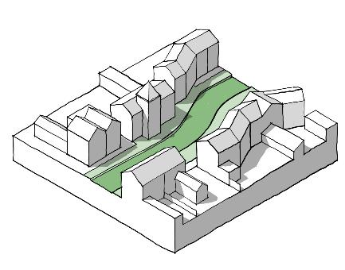
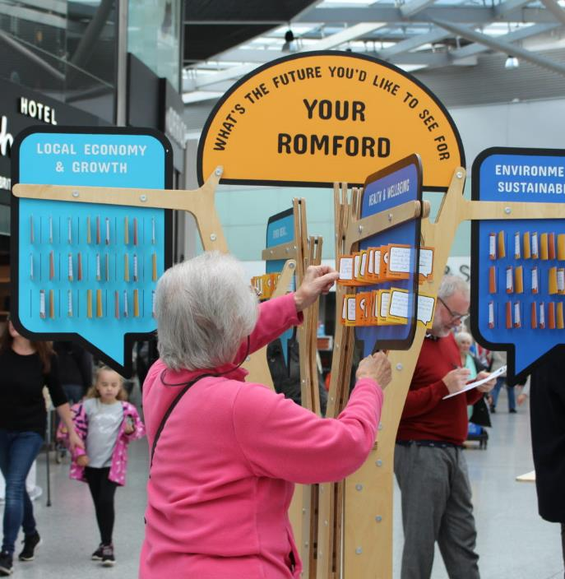
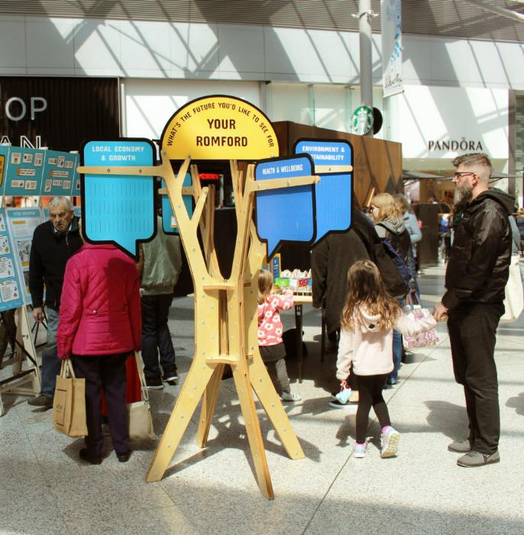
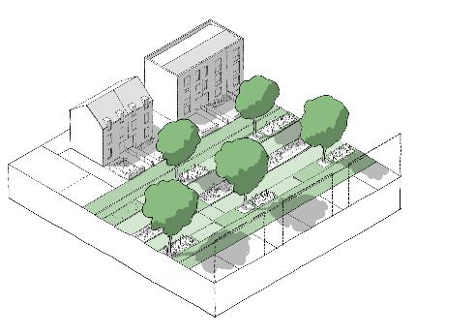
Design codes offer an opportunity to:
Understand each other’s challenges
Help shape the design code in partnership, including testing
Learn the local community’s aspirations and engage with other key stakeholders
Opportunity to shape the code together
Design Council
Images: Make Good and National Model Design Code
Notes:
Engaging with us during the development of this local design code is an opportunity to:
• share your challenges with us, and understand the local authority’s challenges
• input into the design code, and be part of the testing of the design code
• learn what the community’s aspirations are (doing so will help you to submit development proposals that will be supported locally, and likely receive fewer objections at consultation stage)
• engage with other key stakeholders

Slide 33
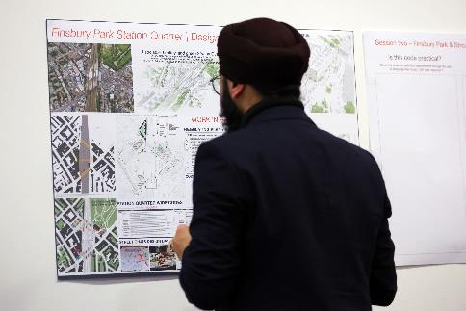
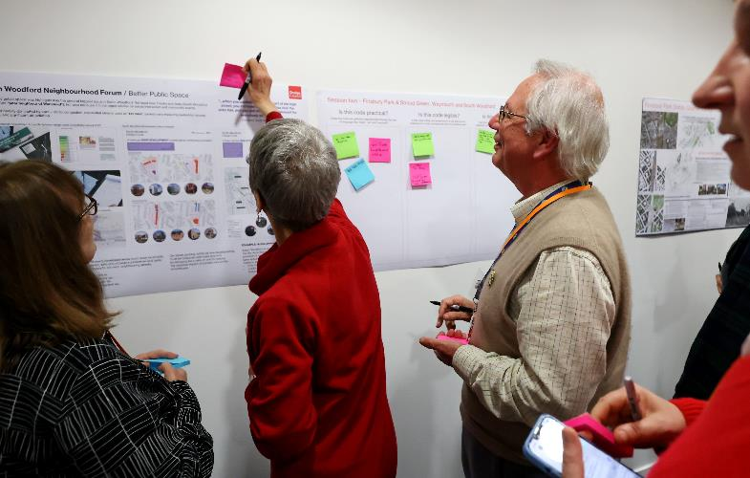
Benefits of developing a local design code
Embed a culture of delivering design quality
Upskilling of officers and members on design matters, using design codes as a tool to train officers in future
Can be used to support plans for investment when bidding or competing for external funding
Images: Design Council
Notes:
Here are some of the benefits of developing a local design code:
We can use the design code and examples of its implementation to train future officers so that understanding of ‘high-quality design’ and feeling empowered to refuse is embedded. It will help to create a culture of delivering high-quality places for our community. Setting clear design standards
can be used to support plans for investment, when bidding or competing for external funding by our partners and stakeholders. A design code can give greater certainty that their plans fit within an overall comprehensive plan. It can also show businesses wanting to come into the area how important the environment and sense of place are for the LA

Slide 34
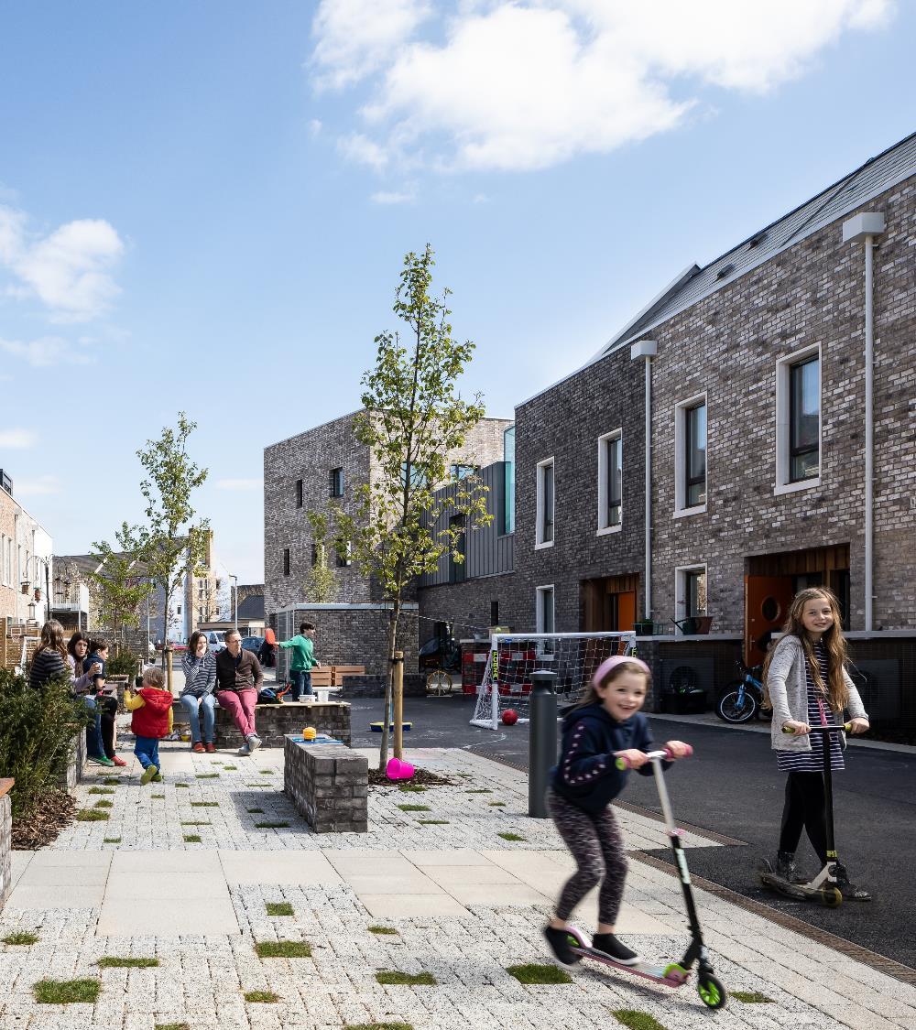
Design codes deliver community aspirations
Democratising the engagement process by involving people in transforming their places.​
Communities have weight in planning decisions, ensuring their expectations are delivered
Design codes are easy to interpret for local planning committees, helping you make informed decisions
Image: David Butler/ Mole Architects
Notes:
Democratising the engagement process: Design codes involve communities in a collaborative process, fostering community input and shared decision-making.
Communities have weight in planning decisions: By incorporating local aspirations, councillors can better represent their constituents and ensure development aligns with community expectations.
Design codes are easy to interpret: Simplified guidelines in design codes provide clarity to local planning committees, enabling informed decision-making and streamlined discussions.

Slide 35
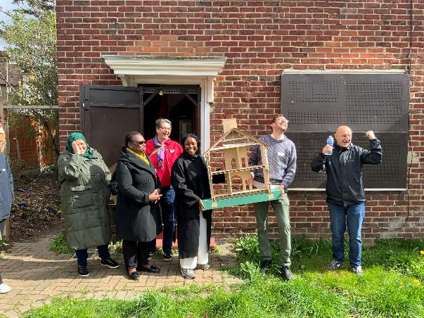
Design codes deliver community aspirations
We want to deliver quality places that build on the community’s vision. To do so we need representative and diverse perspectives.
We want to deliver on your ambitions by:
Understanding what you want to see here
Identifying and addressing issues
Responding to local context and honouring local character
Image (top to bottom): Design Council, Be First

Slide 36
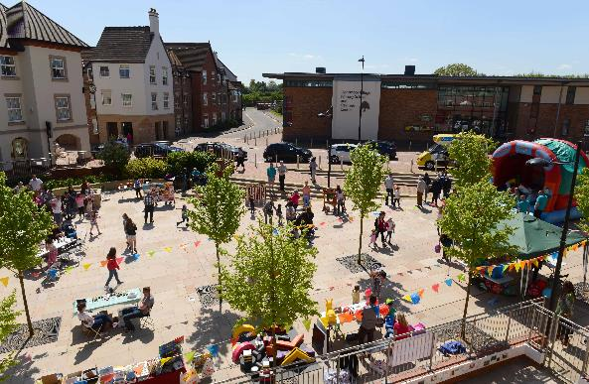
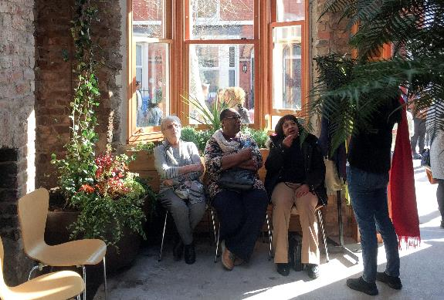
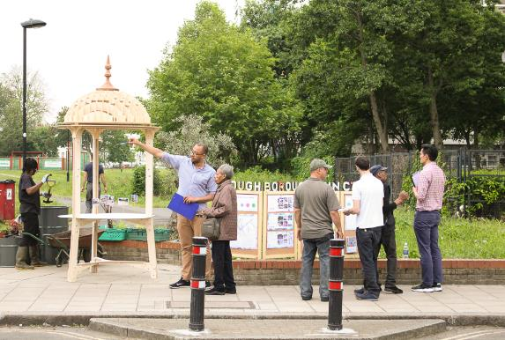
This is an opportunity to:
Understand each other’s challenges
Contribute to better shaping your area for existing and future generations
Engage with other community members
An opportunity to shape your place
To drive up the standard of design where you live and be aware of the principles and expectation placed on those entities that are responsible for development.
Design Council
Image (left to right): Bournville Village Trust, Assemble, Make Good

Slide 37
Thank you
Design Council
Design Council
What is design code?

Slide 38
Contact us
For more information, including a series of learning resources and other tools, please visit:
Design Council: Design Codes
Office for Place
National Model Design Code
National Planning Policy Framework

